Slide 1

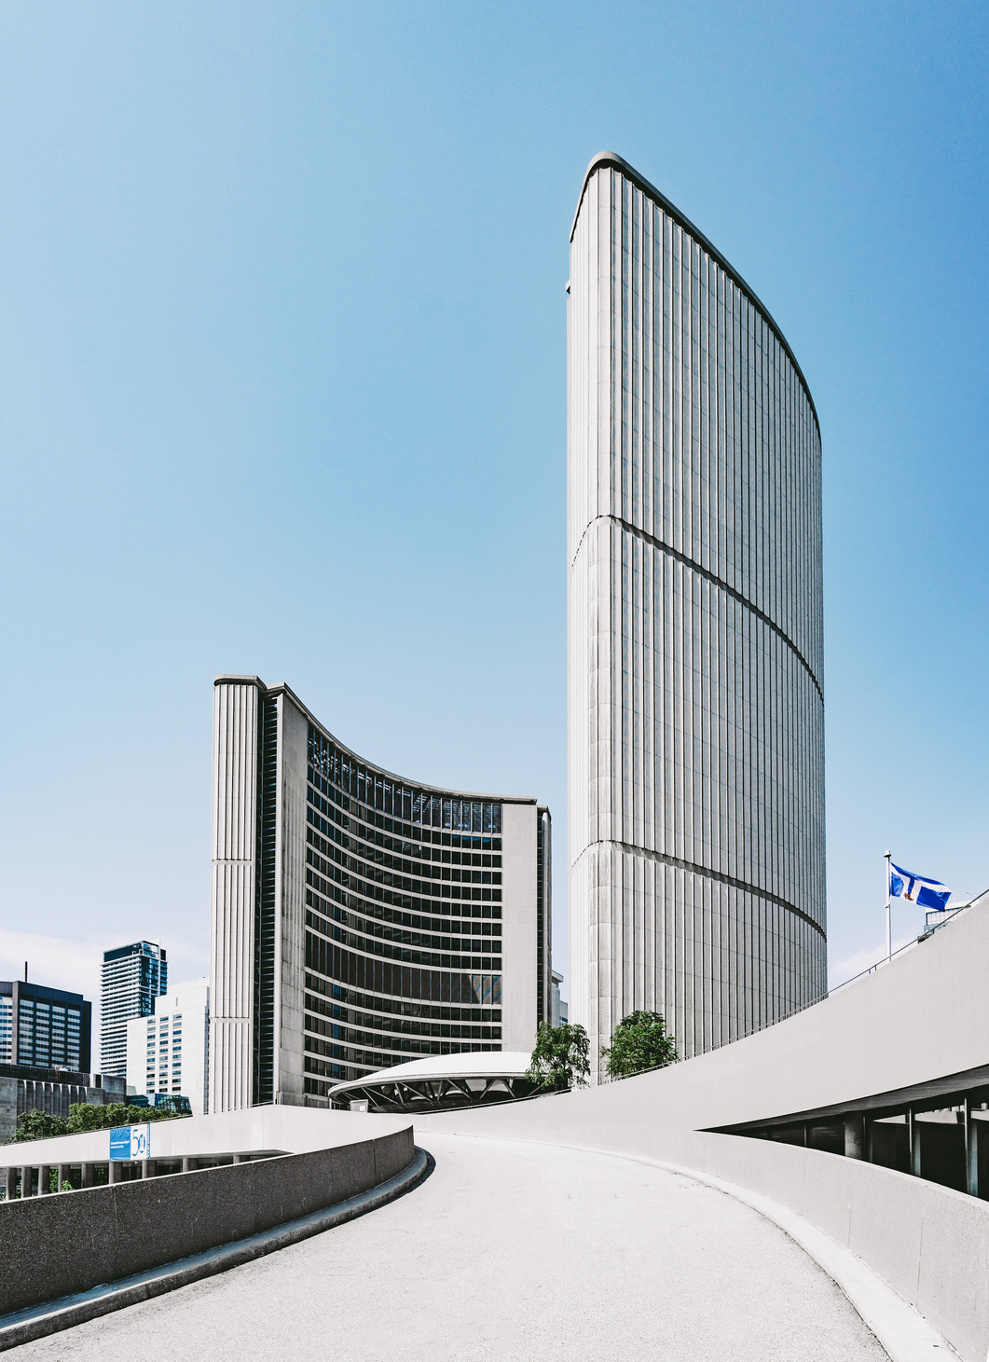


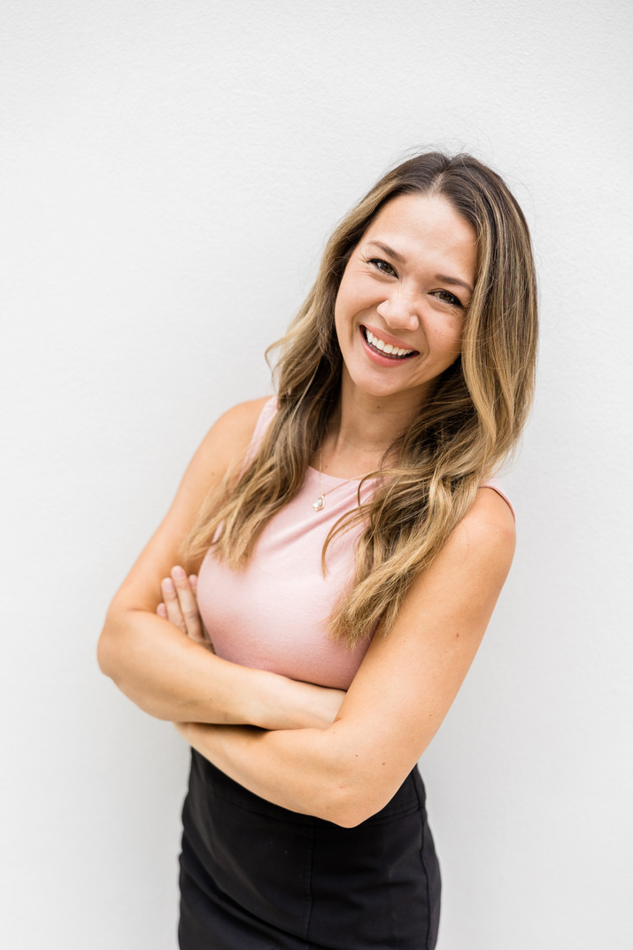


Syria Telecommunication
Company
Predicting
New Client
120+
Churn
50+
Classification using Machine Learning
Competent Talent
SyriaTel wants to reduce customer churn by identifying customers who are at risk of leaving.
Superior Professional Core Competencies
Project by:
Dennis
Muriungi

Slide 2

Business Problem
Customer churn leads to revenue loss
SyriaTel wants to identify customers likely to leave
Early prediction allows proactive retention strategies

Slide 3




Data Understanding
Dataset
Target variable:
Features include:
SyriaTel Customer Churn
Churn (TRUE / FALSE)
Call minutes and charges
International plan usage
Customer service calls

Slide 4



Models Used
01
Logistic Regression
Baseline model
Easy to interpret
Low recall for churned customers
02
Decision Tree
Captures non-linear patterns
Strong improvement in churn detection

Slide 5



Results
Logistic Regression
Churn recall: 14%
ROC-AUC: 0.83
Decision Tree
Churn recall: 80%
ROC-AUC: 0.89
67%
Improvement in model to find churn

Slide 6
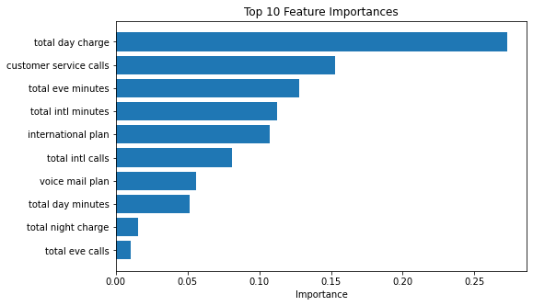
FEATURE
Conclusion &
IMPORTANCE
Recommendations
Decision Tree performed better overall
Decision Tree is the preferred model
Customer service calls strongly indicate
churn
SyriaTel should:
Target high-risk customers early
Improve customer support experience
Market Researcher

Slide 7
Thank for
Your Attention

